Slide 1
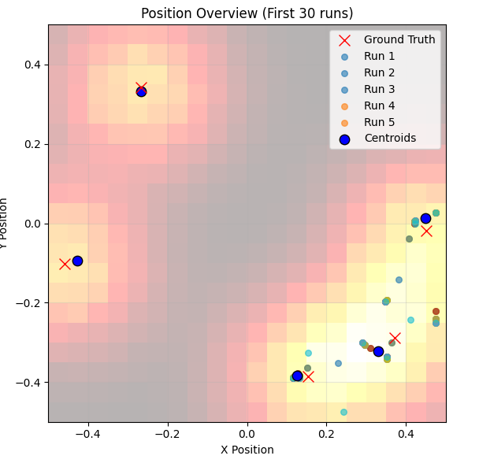
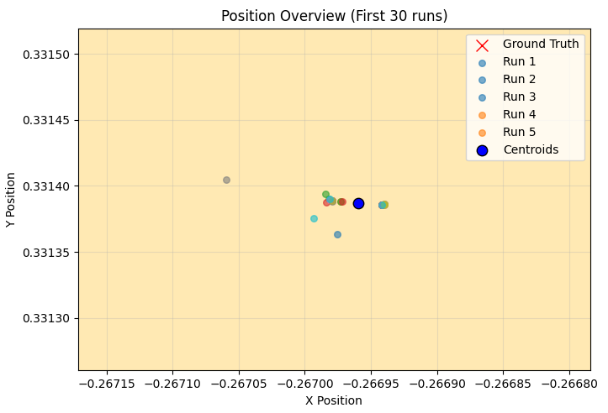
blue: centroid of 30 position estimations
Average per-emitter bias: 36.8 nm. Varies from 10.4 nm to 64.2 nm
Precision varies a lot by emitter (from 0.2 nm to 17 nm)
Notes:
Matching by using hungarian algorithm (computes all distances between GT and estimations, and minimizes total error).

